Slide 1

Creating Azure Policy Compliant Backdoor
Viktor Gazdag

Slide 2

WhoAmI
Principal Security Consultant at NCC Group
Cloud and CI/CD Security
Certs: AZ-104, AZ-400, AZ-500, SC-100, CARTP, CAWASP
Black Hat USA 2022, DefCon 31/32 Cloud Village, DoD CyberDT XSWG #15
https://github.com/woodspeed/conferences

Slide 3
Azure Policy
“Azure Policy evaluates resources and actions in Azure by comparing the properties of those resources to business rules.” - Microsoft
Business rules = I.e.: Resources Only in European Regions

Slide 4
Azure Policy
Policy Definition – JSON
Policy Initiative
Assigned to scope (Mgmt group, Subscription, Resource group, Resource)
Remediation
Policy Initiative(Pol Defs, Rem)->Scope

Slide 5
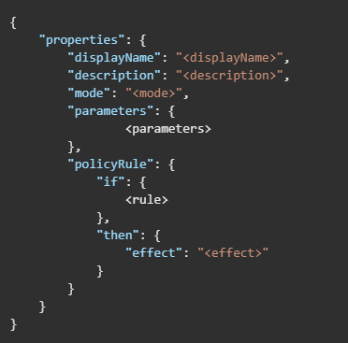
Azure Policy

Slide 6
Elements of Definition
displayName
description
mode
parameters
policyRule
logical evaluations
effect

Slide 7
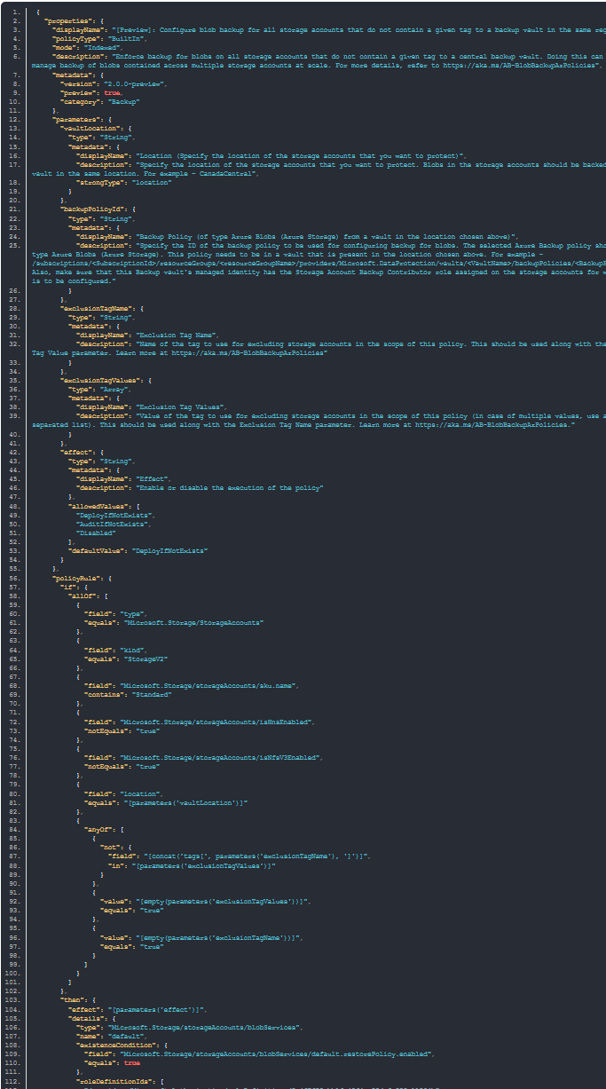
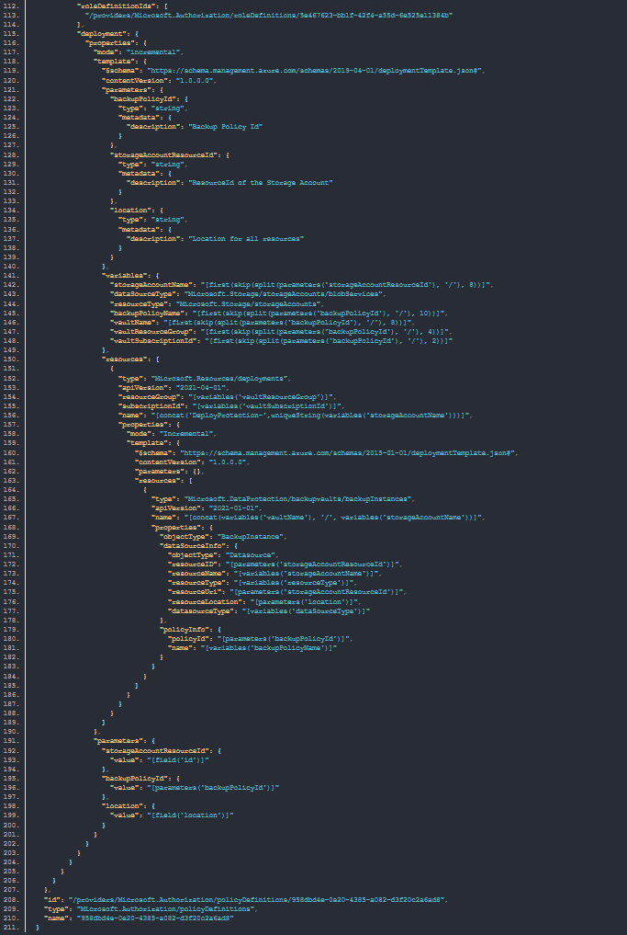

Slide 8
Properties & Alias
Access Resource Type Property
Use Property Alias
And Might Need Resource Property To Be Modifiable

Slide 9
Properties & Alias
Get-AZPolicyAlias
AZ CLI
ARM Template
Deployment Template
Azure Resource Explorer

Slide 10
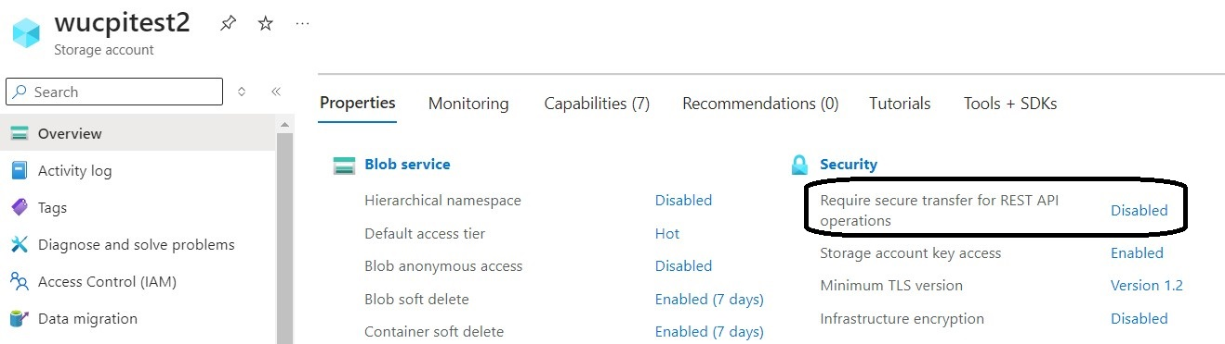
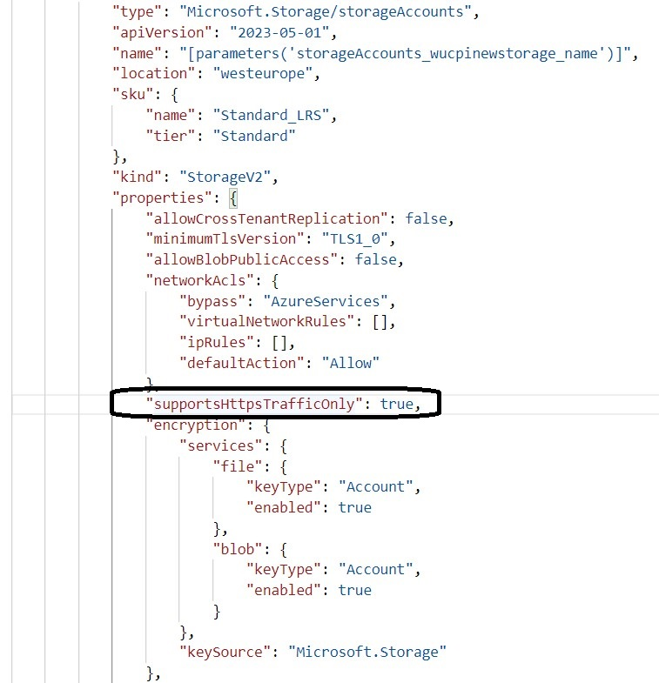
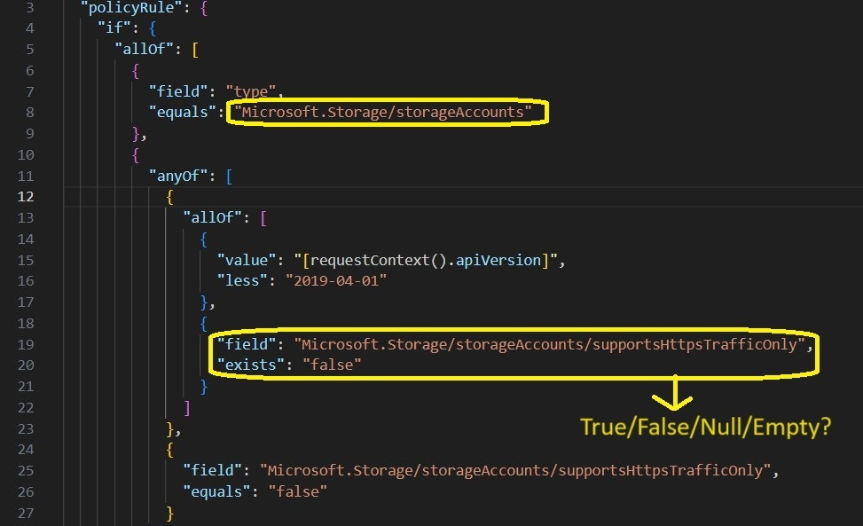

Slide 11
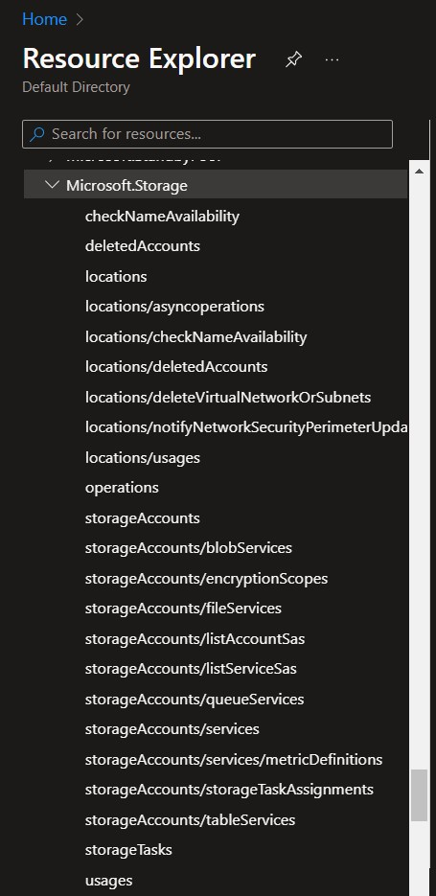
Properties & Alias

Slide 12
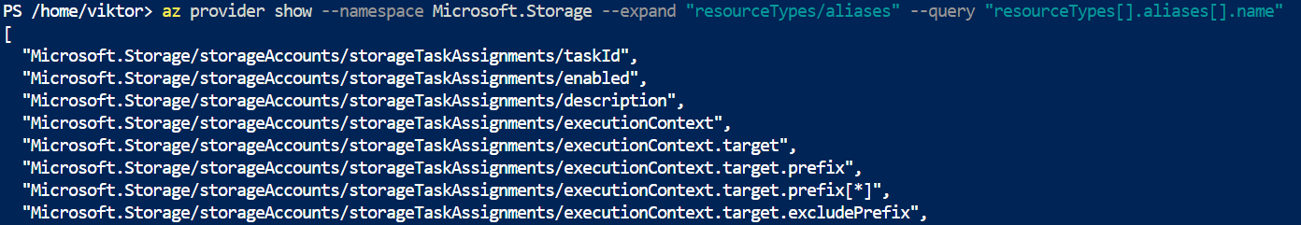
Properties & Alias

Slide 13
Properties & Alias & Modifable
az provider show --namespace Microsoft.Storage --expand "resourceTypes/aliases" --query "resourceTypes[].aliases[].name“
(Get-AzPolicyAlias -NamespaceMatch 'Microsoft.Storage').Aliases

Slide 14
Properties & Alias & Modifable
Get-AzPolicyAlias -NamespaceMatch Microsoft.Sql | where ResourceType -like ‘servers/databases*’ | Select-Object -ExpandProperty ‘Aliases’ | where name -like ‘*backup*’ | Select Name, defaultPath
Get-AzPolicyAlias -NamespaceMatch Microsoft.Sql | where ResourceType -like ‘*servers/database*’ | Select-Object -ExpandProperty Aliases | Where-Object { $_.DefaultMetadata.Attributes -eq ‘Modifiable’ } | where name -like ‘*backup*’ |Select Name,DefaultPath

Slide 15
Azure vs Entra ID

Slide 16
Managed vs Custom Policy

Slide 17
Permission
Microsoft.Authorization
Microsoft.PolicyInsights

Slide 18
Evaluation
A resource is deployed to or updated within a scope
Once every 24 hours, assignments are automatically reevaluated.
On-Demand Possible (I.e.: Call in Automation Account)

Slide 19
Faster Trigger
az policy state trigger-scan --resource-group "demo-rg"

Slide 20
Enumeration
List of Storage Accounts
List of Storage Accounts With Anonymous Access
Virtual Machines With Public IP Address

Slide 21
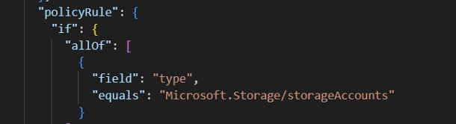

Slide 22
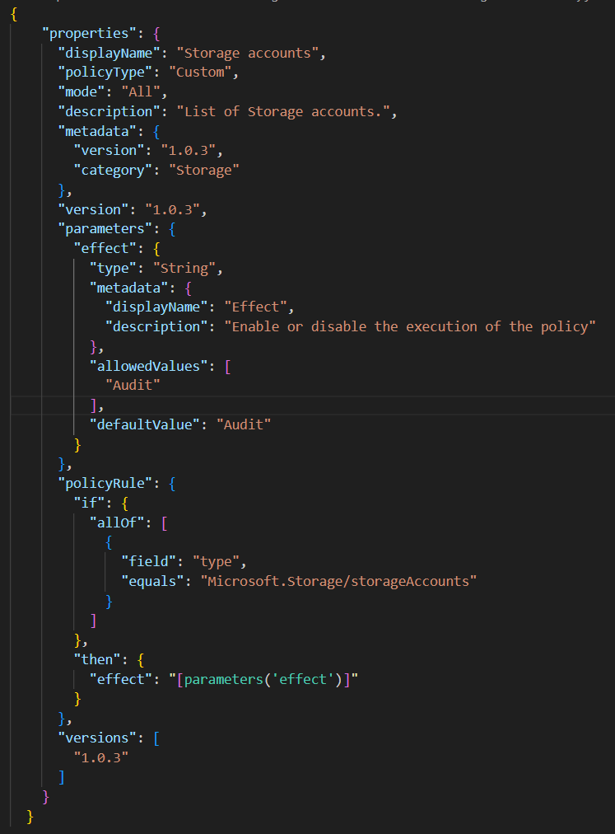

Slide 23
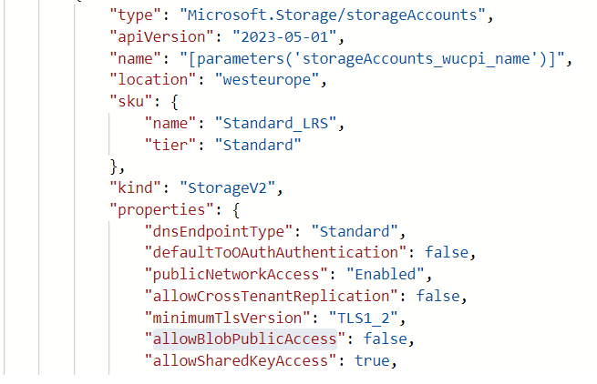

Slide 24
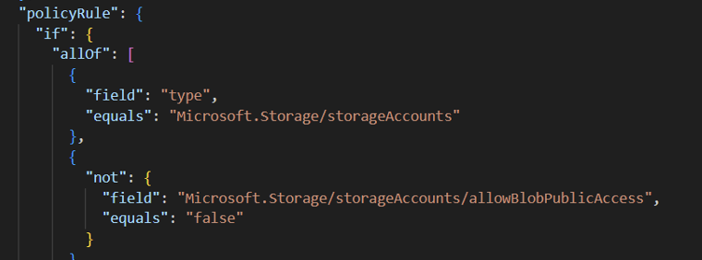

Slide 25
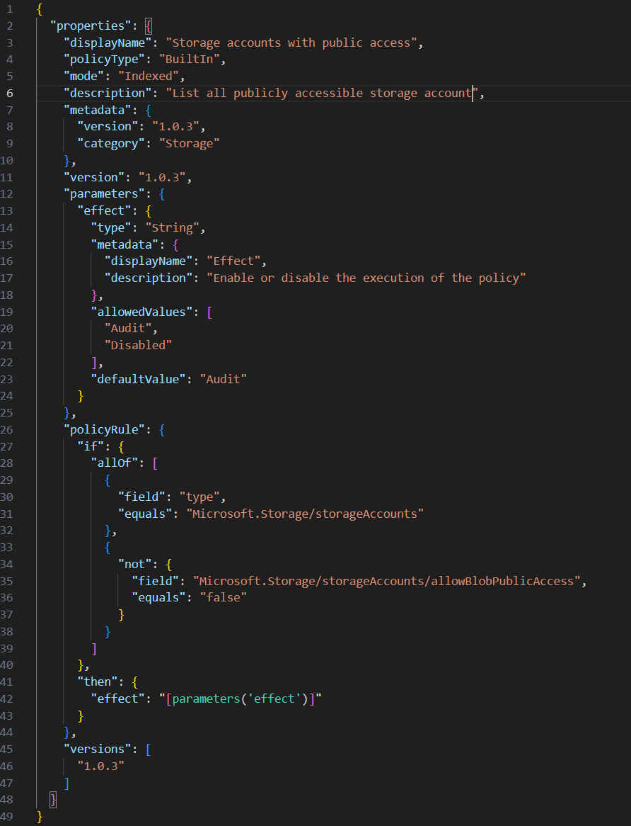

Slide 26
Enumeration
All The Virtual Machines With External IP – Built-In Policy
https://github.com/Azure/azure-policy/blob/master/built-in-policies/policyDefinitions/Network/NetworkPublicIPNic_Deny.json

Slide 27
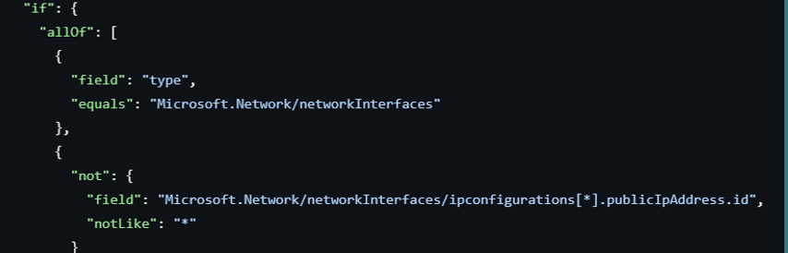
Enumeration

Slide 28
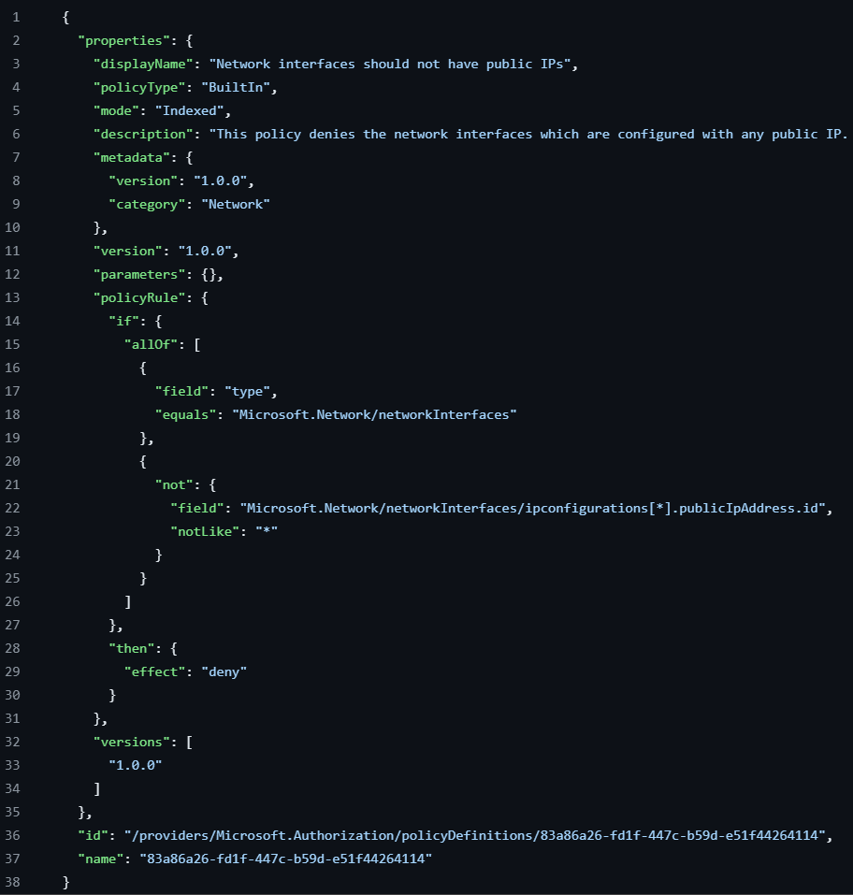

Slide 29
Azure Policy Backdoor Types
Custom Policy with Modify/Append
Custom Policy with DeployIfNotExist and Deployment Script

Slide 30
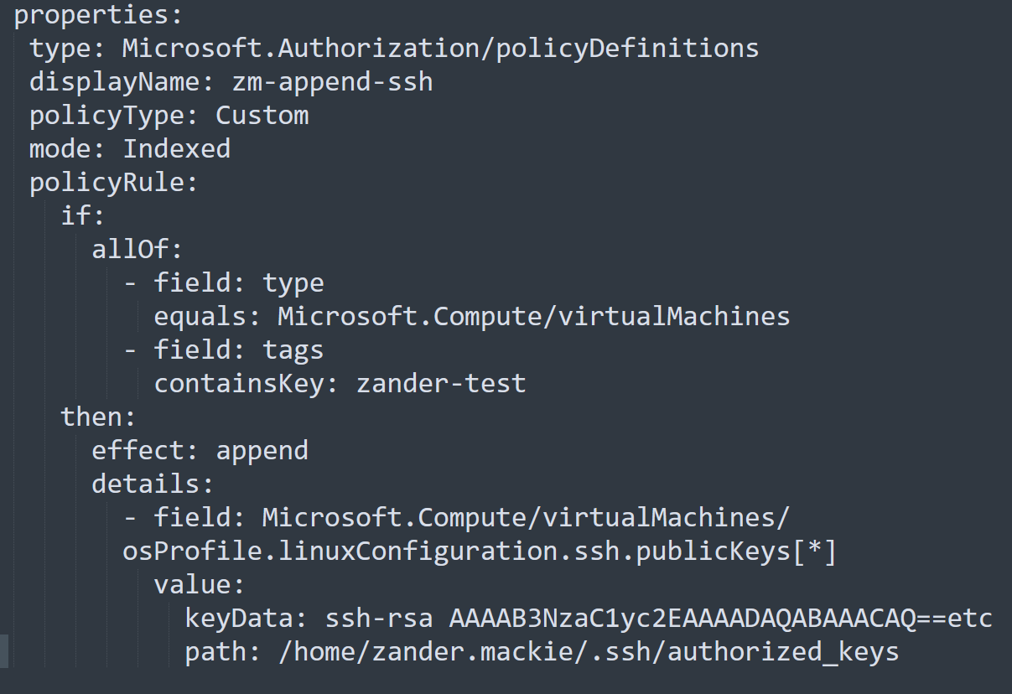
Append Policy
Zander Mackie Blog Post: https://securitylabs.datadoghq.com/articles/azure-policy-privilege-escalation/

Slide 31
Proof of Concept
Check If Storage Account Has HTTPS (supportsHttpsTrafficOnly)
Remediation Task – DeployIfNotExists Effect
Role Assignment To The Managed Identity
Download Deployment Script (PowerShell) From External URL

Slide 32
Proof of Concept
Create A Service Principal
Call Controlled Website With Secret
Triggered By Default Every 24 Hours, But Not The Remediation
The Remediation Task Will Do Other Things As I Modified It (2 MI, 1 ST, 2 Role Assignment)

Slide 33
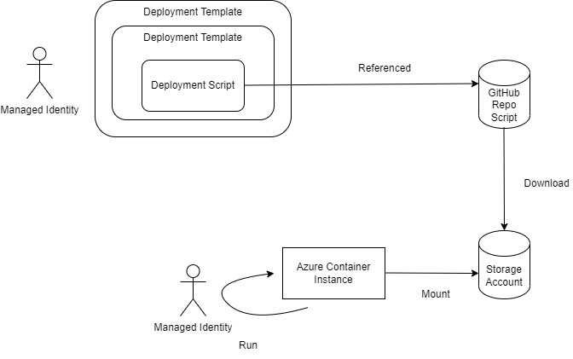
Proof of Concept

Slide 34
Proof of Concept Elements
Storage Account
Managed Identity (For SP Creation – App Admin, User Admin, Owner and Not Contributor)
Azure Container Instance
Deployment
Deployment Script
Website / GitHub

Slide 35
Demo
Video - 8:30 mins

Slide 36
Proof of Concept - Problems
Requires A “LOT”
Basically, Everything Is In Audit Log
Deployment And Script Stored In The Storage Account
Remediation Task Run Only Once

Slide 37
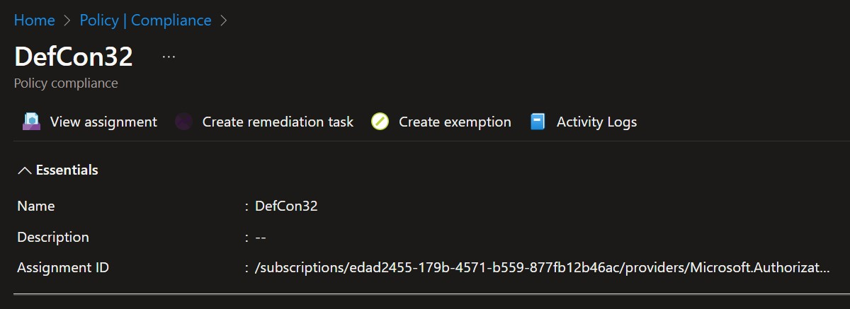
Audit Log

Slide 38
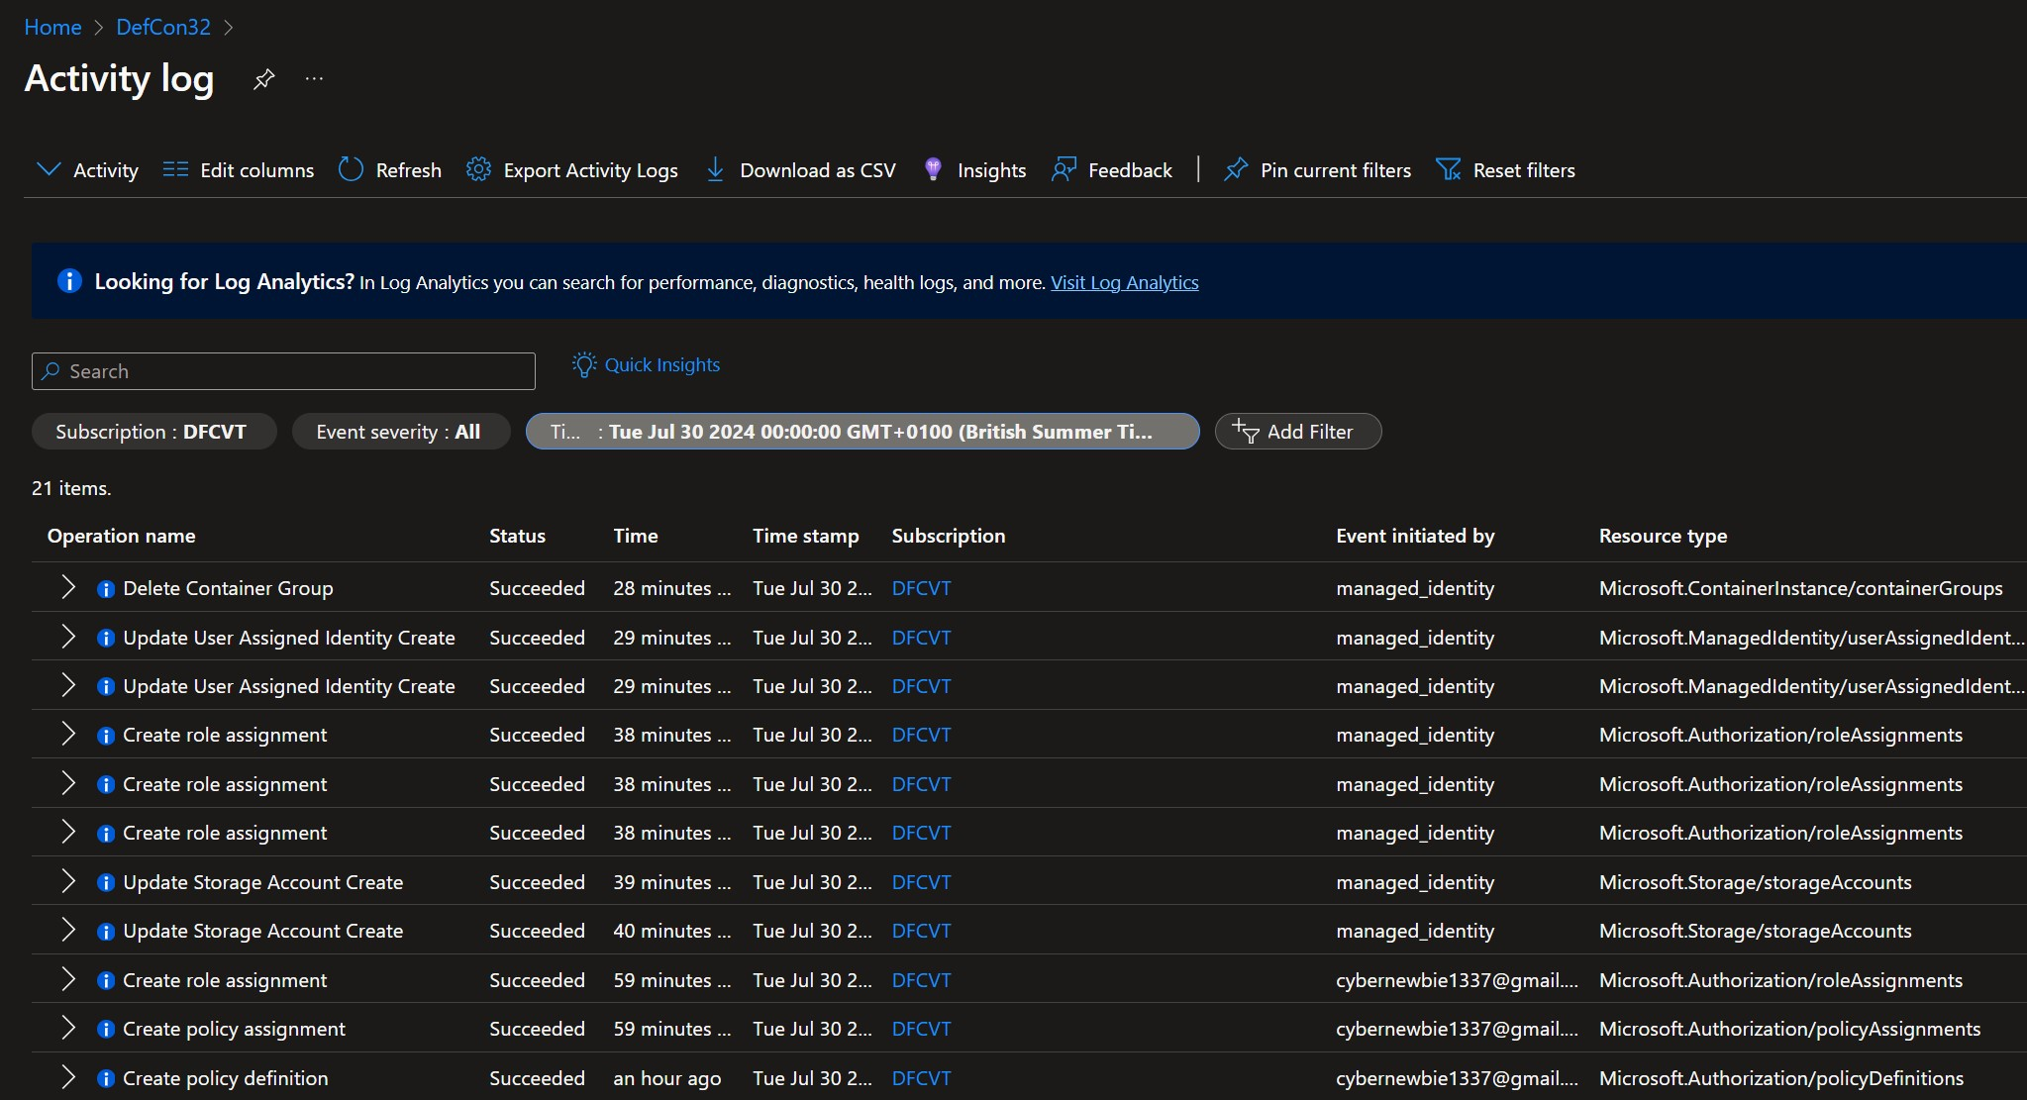
Azure Audit Log

Slide 39
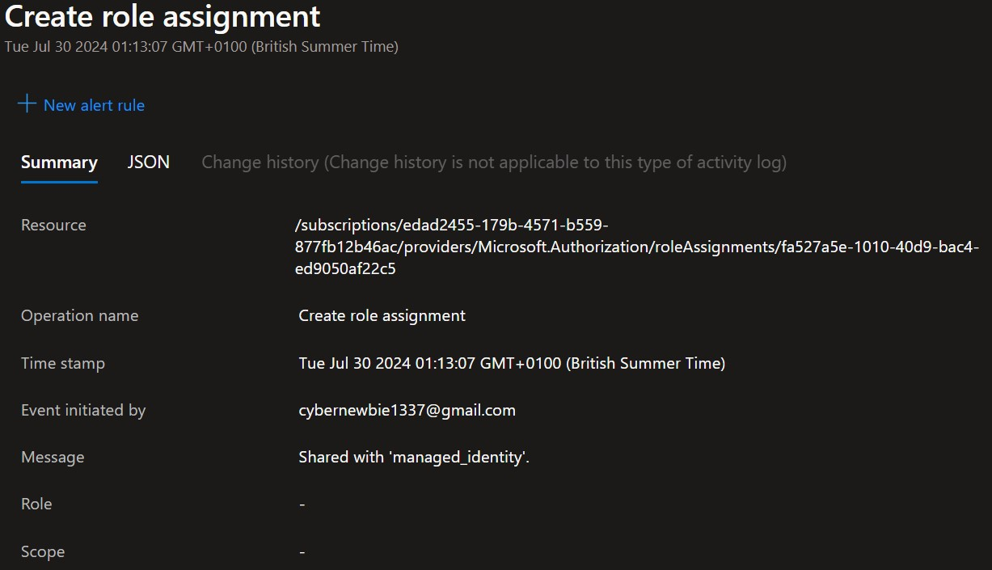
Azure Audit Log

Slide 40
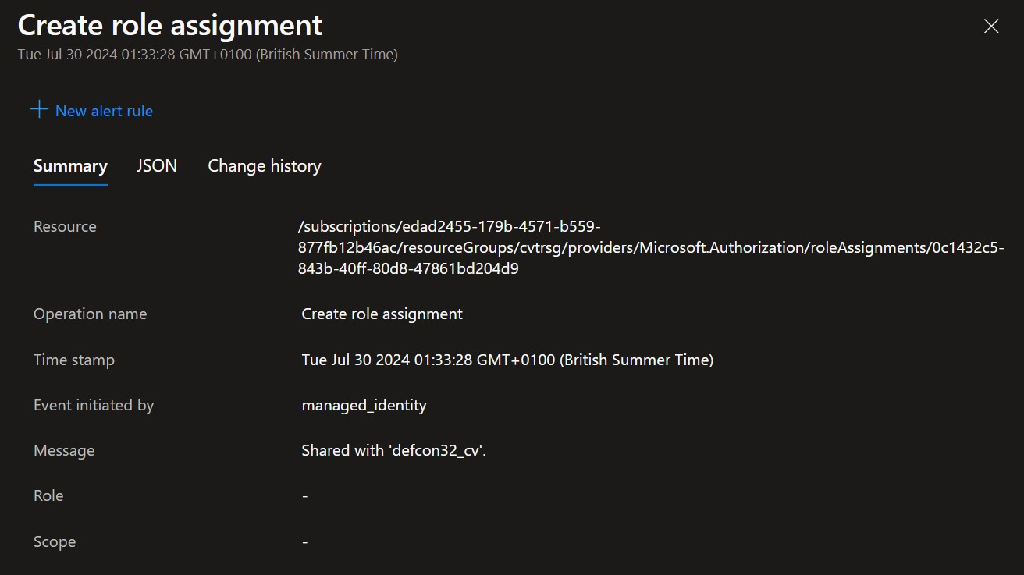
Azure Audit Log

Slide 41
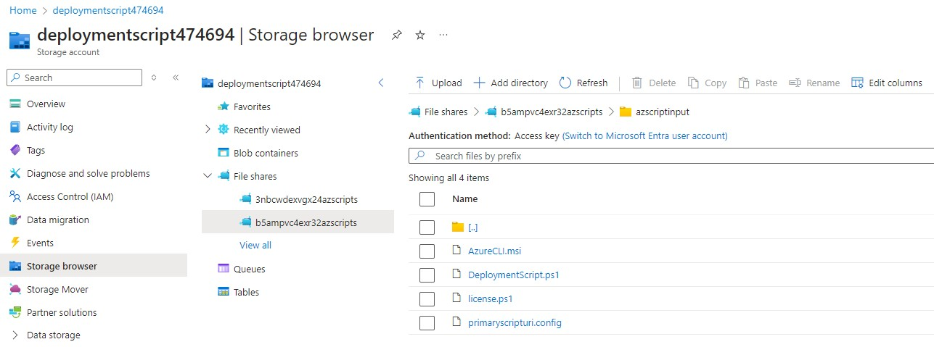
Azure Audit Log

Slide 42
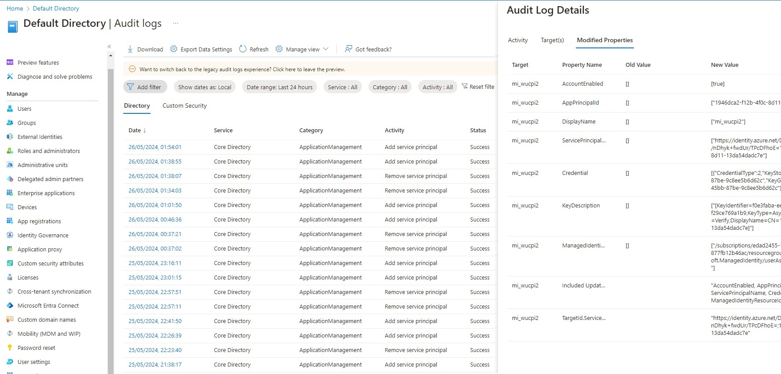
Entra ID Audit Log

Slide 43
Links 1
Original Policy - https://techcommunity.microsoft.com/t5/core-infrastructure-and-security/azure-policy-remediation-with-deployment-scripts/ba-p/1594674
Azure Policy Examples - https://github.com/Azure/azure-policy
Azure Community Policy Examples - https://github.com/Azure/Community-Policy
Azure Policy Examples - https://www.azadvertizer.net/azpolicyadvertizer_all.html

Slide 44
Links 2
https://codingfor.beer/creating-an-azure-policy-remediation-task-for-an-azure-policy-initiative-e75214373c99
https://marcogerber.ch/the-power-of-azure-policy-deployifnotexists/
https://itnext.io/implementing-and-troubleshooting-a-custom-azure-policy-definition-1ab8d0634bb2

Slide 45
Links 3
https://stefanstranger.github.io/2021/01/22/LessonsLearnedDevelopingACustomPolicy/
https://journeyofthegeek.com/2021/03/07/writing-a-custom-azure-policy/
https://msftplayground.com/2022/03/building-your-azure-policies-part-1/

Slide 46
Links 4
https://securitylabs.datadoghq.com/articles/azure-policy-privilege-escalation/
https://medium.com/cyesec/azure-ad-privilege-escalation-through-auto-assignment-policies-2d0422be4f25
https://medium.com/@vladimir.tul/elevating-privileges-through-azure-policy-872298cf673f

Slide 47
Questions
@wucpi
viktor.gazdag@nccgroup.com
https://github.com/woodspeed/conferences

